Slide 1

Notes:
1st slide (Mandatory)

Slide 2

Basic I/O
Scanner class, BufferedReader
Notes:
Cover Page
Font: Nunito Sans
Primary colors: Black, White and Red (#F05136)
General Instruction:
Copy paste the required slide into your PPT. Format it there.
Write less, talk/present more
Use the font Nunito Sans Regular. You can download it from google fonts (https://fonts.google.com/specimen/Nunito+Sans).
Don’t change the size and/or positions of headings, texts, unless absolutely necessary.
The size of the image must be adjusted according to the text (try to make it look visually attractive)
1 image per slide

Slide 3

Scanner class
Easiest way to read input in a Java program but not so efficient.
Used for obtaining the input of the primitive types like int, double, etc. and strings
To read numerical values of a certain data type XYZ, the function to use is nextXYZ().
To read strings, we use nextLine().
To read a single character, we use next().charAt(0). next() function returns the next token/word in the input as a string and charAt(0) function returns the first character in that string.
Notes:
Title + Text

Slide 4
Scanner class - object creation
<class name> <object name> = new <constructor(System.in)> ;
Scanner sc = new Scanner(System.in);
Scanner – Scanner is a class that you create for getting input
sc – Object what we create for scanner class
new – dynamically allocate memory for the object
Scanner() – Constructor to initialize object
System.in – System is the class and in is the object
Notes:
Title + Text

Slide 5
Scanner class methods
nextBoolean() | Reads a boolean value from the user
nextByte() | Reads a byte value from the user
nextDouble() | Reads a double value from the user
nextFloat() | Reads a float value from the user
nextInt() | Reads a int value from the user
nextLine() | Reads a String value from the user
nextLong() | Reads a long value from the user
nextShort() | Reads a short value from the user
Notes:
Title + Image + Text

Slide 6
Write a program for getting all inputs and display.
Notes:
Title + Text

Slide 7

import java.util.Scanner;
public class ScannerDemo1
{
public static void main(String[] args)
{
// Declare the object and initialize with
// predefined standard input object
Scanner sc = new Scanner(System.in);
// String input
String name = sc.nextLine();
char gender = sc.next().charAt(0);
// Numerical data input
// byte, short and float can be read
// using similar-named functions.
int age = sc.nextInt();
long mobileNo = sc.nextLong();
double cgpa = sc.nextDouble();
// Print the values to check if the input was correctly obtained.
System.out.println("Name: "+name);
1
2
3
4
5
6
7
8
9
10
11
12
13
14
15
16
17
18
19
20
21
22

Slide 8
System.out.println("Gender: "+gender);
System.out.println("Age: "+age);
System.out.println("Mobile Number: "+mobileNo);
System.out.println("CGPA: "+cgpa);
}
}
1
2
3
4
5
6
7
8
9
10
11
12
13
14
15
16
17
18
19
20
21
22

Slide 9
Command Line Arguments
The java command-line argument is an argument i.e. passed at the time of running the java program
The arguments passed from the console can be received in the java program and it can be used as an input.
Notes:
Title + Text

Slide 10
Command Line Arguments
Used to specify configuration information while launching your application.
No restriction on the number of java command line arguments. You can specify any number of arguments
Information is passed as Strings
They are captured into the String args of your main method
Notes:
Title + Text

Slide 11
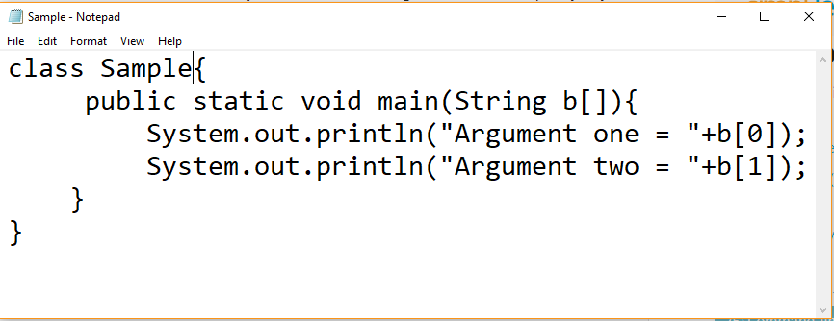
Command Line Arguments - Tutorial
Step 1 – Load the program
Notes:
Title + Text

Slide 12
Command Line Arguments - Tutorial
Step 2 – Compile the code
Step 3 – Run the program
java Sample Focus Academy
Notes:
Title + Text

Slide 13
class Sample{
public static void main(String b[]){
System.out.println("Argument one = "+b[0]);
System.out.println("Argument two = "+b[1]);
}
}
1
2
3
4
5
6
7
8
9
10
11
12
13
14
15
16
17
18
19
20
21
22

Slide 14
OUTPUT
>javac Sample.java
>java Sample Focus Academy
>Argument one = Focus
>Argument two = Academy
Notes:
Output

Slide 15

Question 1
Which of these packages contain classes and interfaces used for input & output operations of a program?
A)
java.util
B)
java.lang
C)
java.io
D)
None of these
Notes:
Question + Large Options (2Lines)

Slide 16

THANK YOU
Notes:
Thank you slide

